Slide 1
On Dataless Hierarchical Text Classification
Yangqiu Song and Dan Roth
Computer Science Department
University of Illinois at Urbana-Champaign
2014
Notes:
Hi, today I am going to talk about dataless hierarchical text classification. This is a joint work with Dan Roth.

Slide 2
Document Classification
On Feb. 8, Dong Nguyen announced that he would be removing his hit game Flappy Bird from both the iOS and Android app stores, saying that the success of the game is something he never wanted. Some fans of the game took it personally, replying that they would either kill Nguyen or kill themselves if he followed through with his decision.
Pick a label:
Class1 or Class2 ?
Mobile Game or Sports?
Labels carry a lot of information!
But traditional approaches are not using it
Models are trained with “numbers or IDs” as labels
Notes:
Document classification is a classic problem for text mining and nlp applications. The task is to predict the label of a document.
Traditional classification often treats the labels as numbers or IDs to train a classifier for such task.
However as a human, if I want you to choose a label of the document like this, can you tell me which label it is?
No, right? But if I give you the label names, you can easily tell me the decision without any problem.
So the labels really carry a lot of information about the category meaning. If we know the label names, we can even classify the document without any labeled data.
But even with label names, the traditional classification models still treat the labels as numbers or ids and do not consider this information.

Slide 3
Dataless Classification
Chang, M.; Ratinov, L.; Roth, D.; and Srikumar, V. Importance of semantic represenation: Dataless classification. In AAAI. 2008.
Elhoseiny, M.; Saleh, B.; and A.Elgammal. Write
a classifier: Zero shot learning using purely textual descriptions. In ICCV, 2013.
Dataless definition
No labeled data for training
Depend on understanding the labels
Zero-shot learning in computer vision
The importance of semantic representation
A news article: Sports or Mobile Game?
names of players,
teams,
activities of a match
without mentioning the word sport(s)
All about representation of documents and labels
Mobile Game or Sports?
Notes:
In this work, we introduce dataless classification. It means we classify the text data only based on the label names or simple descriptions.
With this setting, traditional representation based on bag-of-words may not work for many cases. For example, for a document that talking about sports, it can mention names of players, teams, activities of a match etc, but when we compare it with the label sports, there is no overlapped keyword.
Therefore, to find a better semantic representation for both documents and labels is the key issue in dataless classification.
Given a good representation, we can easily compare the pairwise similarities to get the best guess of labels.

Slide 4
Outline
Pure Dataless Hierarchical Classification
Text Representations
Bootstrapping with unlabeled data
Notes:
In this talk, I will introduce Hierarchical Classification based on label representation. Then I will show the effect of different representations. Finally I show how to bootstrap the learning procedure with more unlabeled data.

Slide 5
Hierarchical Classification
Top-down classification
Bottom-up classification (Flat classification)
Root
Root
Root
A
B
B
B
…
N
1
2
…
M
1
2
2
2
…
1
2
…
Possible to select top K to propagate
Notes:
Hierarchical classification is to classify documents onto a given hierarchy of labels.
It is then natural to consider a top-down or bottom-up way to classify the documents.
A top-down algorithm starts from the root node, and greedily finds the best children to further compare.
A bottom-up algorithm first compares all the leaves nodes in the tree, and propagates the labels with high confidence scores to the root. It equals to a flat classification of all the leave nodes.
Note that, this framework can also be extended by selecting the top K nodes to propagate, which is the multi-label classification problem.

Slide 6
Text Representation
Explicit Semantic Analysis (ESA)
Gabrilovich and Markovitch. AAAI, 2006; IJCAI, 2007; JAIR 2009.
Brown Clusters
Brown et. al, Computational Linguistics, 1992.
Neural Network Word Embedding
Mikolov et. al. NIPS and HLTNAACL, 2013.
Collobert et. al. JMLR, 2011.
Turian et. al, ACL, 2010.
Notes:
So the problem is how to compare the documents and labels by generating meaningful text representations. We compared three approaches, the explicit semantic analysis, brown clusters and word embedding methods.

Slide 7
Explicit Semantic Analysis (ESA)
Gabrilovich and Markovitch. AAAI, 2006; IJCAI, 2007.
Build an inverted index for Wikipedia articles
Use each word to search Wikipedia
get concepts for each word
Merge the retrieved concepts weighted by the TFIDF scores of words in document
Represent text as bag of Wikipedia titles
Barack Obama
Timeline of the presidency of Barack Obama (2009)
Family of Barack Obama
Barack Obama citizenship conspiracy theories
Barack Obama
Barack Obama presidential primary campaign 2008
University of Illinois at Urbana Champaign
Champaign Illinois,
Champaign–Urbana metropolitan area,
Urbana Illinois,
University of Illinois at Urbana–Champaign,
Illinois locations by per capita income,
Notes:
ESA first builds an inverted index of wikipedia articles.
Then it searches the index for each word in a document.
Finally it merges the retrieved concepts weighted by the TFIDF scores in document.
Here are two examples of the ESA results.
We can see that ESA uses the wikipedia titles as the description of concepts, and represents the document in the concept space.

Slide 8
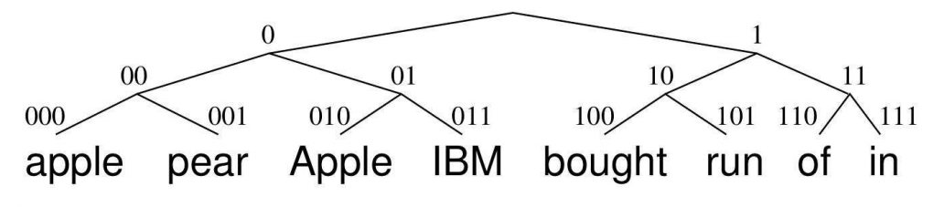
Word Brown Clusters
Brown et. al, Computational Linguistics, 1992.
Step 1: Generate a hierarchical tree of distributional word clusters
Step 2: Represent each word by its path from root to cluster
Step 3: Represent each document by the ensemble of its word clusters
TFIDF weighted average of the word cluster vector
Word 1
Word 2
Word n
Cluster 1
+
+
…
+
Cluster 3
W1
W2
Wn
…
Document representation
Dimensionality = log(# clusters)
Notes:
Brown cluster generates a hierarchical tree of word clusters by evaluating the word co-occurrence based on their context.
For example, since the words apple and pear appear in similar contexts, the Brown clustering algorithm will assign them to the same cluster. To generate a document representation, we first represent each word by its path from root to leaf in the hierarchy.
Then we represent the document by the ensemble of its word clusters.
When we use number of clusters as a parameter, it is actually unfair for brown clusters to compare with the other approaches. Because we actually use smaller intrinsic dimensionality than the other representations.

Slide 9
Neural Network Word Embedding
Step 1: Use neural network embedding to generate representation for words
The representations are trained via different neural network architectures
Step 2: Represent a document
Compute TFIDF weighted average of word vectors
Mikolov et. al. NIPS and HLTNAACL. 2013.
Collobert et. al. JMLR 2011. (Senna)
Turian et. al, ACL, 2010.
Word 1
Word 2
Word n
+
+
…
+
W1
W2
Wn
Document representation
Notes:
Finally we generate text representation based on neural network word embedding.
We first generate different embedding results of words using different neural network architectures. In general, the representation reflects the context similarity of words. For example, we can compute the word or phrase similarity in the semantic space.
Then for documents, we simply compute the representation based on the tfidf weighted average.

Slide 10
Summary
Label
(description)
sci.electronics: science electronics
comp.graphics: computer graphics
sci.med: science medicine
Label Representation
Similarity
Word Representation
Document Representation
Document
Method | Representation | Features
Bag-of-words | Sparse Vector | Words’ TFIDF
ESA | Sparse Vector | Wikipedia title weights
Brown Cluster | Sparse Vector | Path from root to cluster
Word Embedding | Dense Vector | Learned real values
Notes:
In summary, given the label and the document, we first build their representations based on some word representation. Then we compare the similarity to select best labels as the classification result.
For different representations, we use different kinds of features. In bag-of-words, we simply use TFIDF features. In ESA, we use Wikipedia concepts to construct sparse vectors. For brown cluster, we construct sparse vectors based on the path from root to cluster. For word embedding, we merge the dense vectors to have a more compact representation.

Slide 11
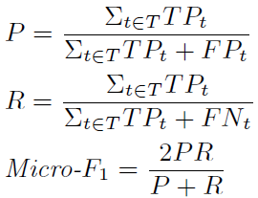
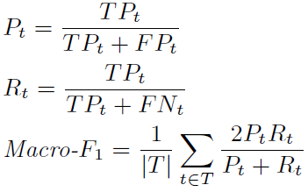
Datasets and Evaluation
20newsgroups
Level 1: 6 classes
Level 2: 20 classes
Micro-F1
RCV1
82 categories with maximal depth four
In total 103 nodes in the hierarchy
Macro-F1
Notes:
We use two datasets to evaluate the performance. The first data is 20newsgroups and the second is the RCV1 data.
We use two metrics to evaluate the results.
Micro-F1 is a conventional metric used to evaluate the classification decisions.
MacroF1 is the average of F1 scores on all the nodes, which are weighted equally.

Slide 12
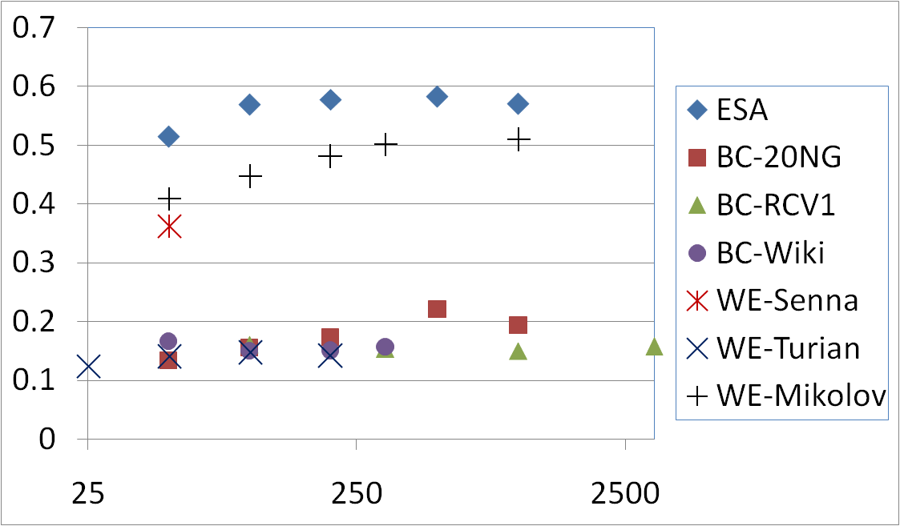
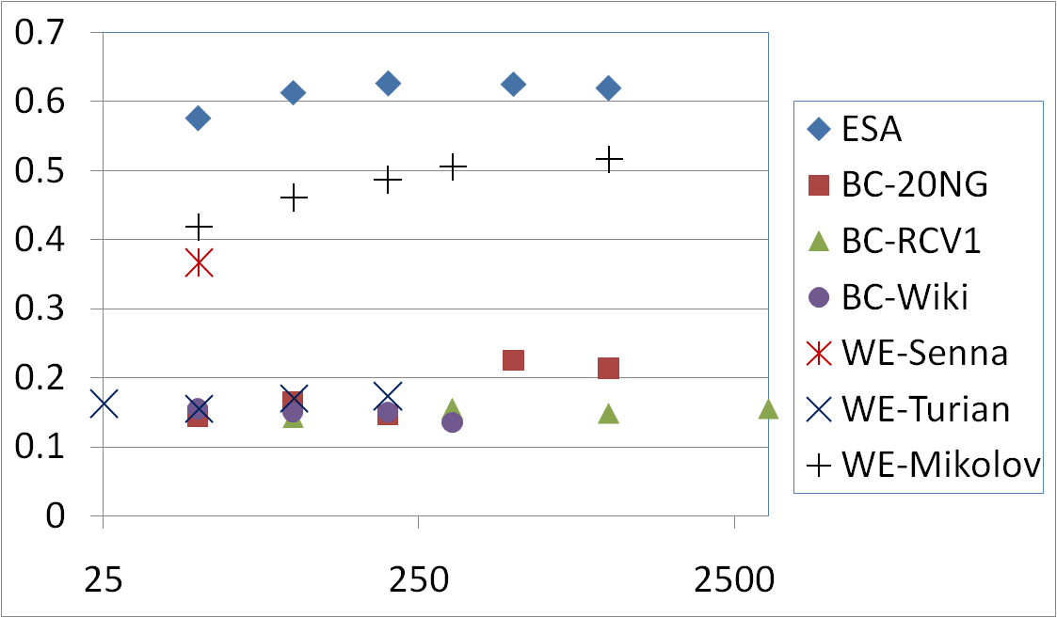
Evaluation on 20newsgroups Data
Hierarchical Classification (layer 1: 6 classes, layer 2: 20 classes)
ESA
Word Embedding (Mikolov, Wiki)
Word Embedding (Senna, Wiki)
Brown Cluster (Wiki)
Word Embedding (Turian, RCV1)
Brown Cluster (20NG)
Top-down Bottom-up
Brown Cluster (RCV1)
X-axis
ESA: Number of concepts
BC: Number of clusters in word hierarchy
Dimensionality = log(# clusters)
WE: Number of dimensions of word embedding
Notes:
We first show the results on 20newsgroups data.
We train brown clusters based on 20newsgroups, RCV1 and wikipedia. All the Brown cluster representations do not show promising results on the dataset. This may be because firstly the intrinsic dimensionality of brown cluster is much less than the others. It is a little bit unfair for BC. Second, when we aggregate all the words’ clusters, it may become less distinguishable for different documents since they share a lot of common word clusters near the root.
ESA performs the best on this data set. In general, with more concepts in the representation, the classification results are better.
The word embedding trained on wikipedia is also promising. We see the Mikolov’s word2vec is slightly better than the embedding used in Senna. The word embedding based RCV1 performs worst for 20newsgroups data.
Finally we can see that bottom-up classification is slightly better than top down. Because in dataless classification, the classifier is built on “understanding” the labels and the documents. When the meaning of a leaf node is quite good, it seems there is no need for a top-down mechanism to eliminate the lack of data problem in the leaves.

Slide 13
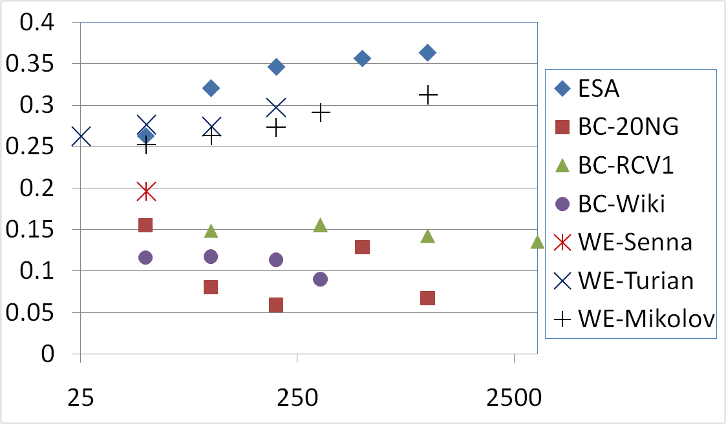
Evaluation on RCV1 Data
Hierarchical Classification 109 classes
ESA
Word Embedding (Turian, RCV1)
Word Embedding (Mikolov, Wiki)
Top-down Bottom-up
X-axis
ESA: Number of concepts
BC: Number of clusters in word hierarchy
Dimensionality = log(# clusters)
WE: Number of dimensions of word embedding
Notes:
Similarly, for RCV1 dataset, ESA performs the best. Interestingly, the word embedding method based on RCV1 data performs relatively good in this case. Therefore, the corpus for training the representation is also very important. If there is no knowledge about it, we can see that using wikipedia is a good choice.

Slide 14
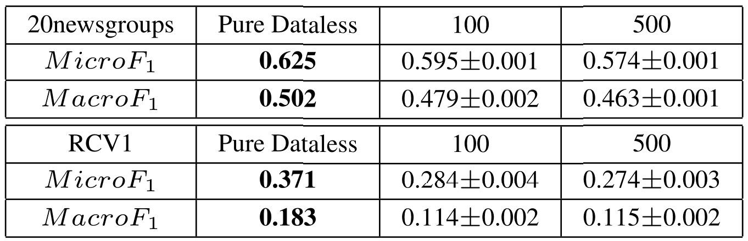
Comparing to Unsupervised Baseline
Ontology Guided Hierarchical LDA
(Ha-Thuc, V., and Renders, J.-M. 2011. Large-scale hierarchical text classification without labeled data. In WSDM)
Use labels to search Wikipedia and retrieve relevant documents
Perform ontology guided latent topic model
Classify new documents based on topic assignments
Number of searched Wikipedia articles
for training hierarchical topic model
Notes:
We also compare the results with an unsupervised classification baseline. The idea is to learn topics from the documents retrieved by the labels. We can see that dataless classification based on representation can be better than retrieving 100 and 500 documents for each label respectively.

Slide 15
Outline
Pure Dataless Hierarchical Classification
Text Representation
Bootstrapping
Knowing the unlabeled data collection helps
We can learn specific biases of the dataset
For example, documents in politics newsgroup are about the politics of sexual orientation
Dataless + semi-supervised learning
Notes:
Till now we have shown the pure dataless classification and the effect of text representation.
We also note that the unlabeled data can further help us improve the classification results. For example, Unlabeled data can help us to eliminate the classification bias for the documents in politics newsgroup which are actually about the politics of sexual orientation.
Therefore, we propose a simple but effective bootstrapping mechanism to enhance the results of dataless classification.

Slide 16
Dataless Classification with Bootstrapping
Initialize N documents for each label
Pure dataless classifications
Train a classifier to label N more documents for each label
Continue until no unlabeled document
Notes:
In the bootstrapping algorithm, we first initialize N documents for each label using pure dataless classification. Then we train a supervised classifier based on the labeled data, and use it to label N more documents for each label. We label all the training set until there is no unlabeled document.

Slide 17
Compared to Supervised Baselines
Results on 20 newsgroups
Notes:
We can see that dataless classification is comparable to supervised classification with more than one thousand labeled documents.

Slide 18
Conclusions
Thank you!
It is possible to classify documents into multiple (hierarchical) categories
Via embedding text and labels in a semantic representation space
We have:
A systematic comparison of different representations
Study dataless hierarchical classification
Bottom-up vs. Top-down
Perform bootstrapping improve classification performance
The classification quality is better than it looks from the evaluation
Possibility of classifying document in a larger, open-domain label space
http://cogcomp.cs.illinois.edu/page/software_view/DatalessHC
Notes:
To conclude, we have shown that it is possible to classify documents into multiple hierarchical categories. The most important thing is to represent both document and labels in a good enough semantic representation space.
Specifically, in this work, we compared different text representations for dataless classification.
We also study the bottomup and topdown mechanisms of hierarchical classification.
Finally we introduce bootstrapping algorithm to use unlabeled documents to further improve classification results.
Really the classification quality is better than it looks from the evaluation. For evaluation, we had to use the existing label space for this collection. But it is not necessarily the best label space. In practice , using a larger label space should improve the results.
We have released our code here. You can check if interested.

Slide 19
Thank you!
Notes:
Thank you for your attention.

Slide 20

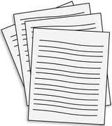
Traditional Text Categorization
Class 1
Class 2
Label/Document
Understanding
?
Sports
Entertainment
…
Training
?
Class 1
Class 2
Model
Notes:
For example, in traditional text categorization, we are given piles of labeled documents, and then we learn a classification model to distinguish the categories.
Then for the new coming documents, we want to predict their class labels.
But the problem is that if we know the labels themselves, can we directly classify the document into the categories described by the labels?? In this work, we target to explore ways that perform classification without any labeled data, but by understanding the meaning of labels.

Slide 21
Traditional Classification vs. Dataless Classification
Traditional Classification
Learn:
Classify:
E.g.,
Dataless Classification
Learn (find): representation
Classify:
E.g.,
Notes:
We can compare the traditional classification with dataless classification as follows.
For the learning step, traditional learning algorithm learns from given labeled examples, to find a projection vector for each class. Dataless classification learns or simply finds the best representation of both documents and labels.
For classification, traditional classification finds the best label by projecting the document on a scalar value, while dataless classification finds the nearest label to assign.
For example, for traditional classification, if we take softmax, then the classification equals to find the maximum value of the projection score. For dataless classification, if we normalize the vectors to unit length, then the classification is quite similar. Here we can build a connection between the projection vector and the label representation vector.

Slide 22
Neural Network Word Embedding
Step 1: Use neural network embedding to generate representation for words
Step 2: Represent a text fragment
Compute TFIDF weighted average of word vectors
cat
dog
Mikolov et. al. NIPS and HLTNAACL. 2013.
Collobert et. al. JMLR 2011. (Senna)
Turian et. al, ACL, 2010.
chair
table
Word 1
Word 2
Word n
+
+
…
+
W1
W2
Wn
Document representation
Notes:
Finally we generate text representation based on neural network word embedding.
We first generate different embedding results of words. The representation reflects the context similarity of words. For example, we can compute the word or phrase similarity in the semantic space.
Then for documents, we simply compute the representation based on the tfidf weighted average.

Slide 23
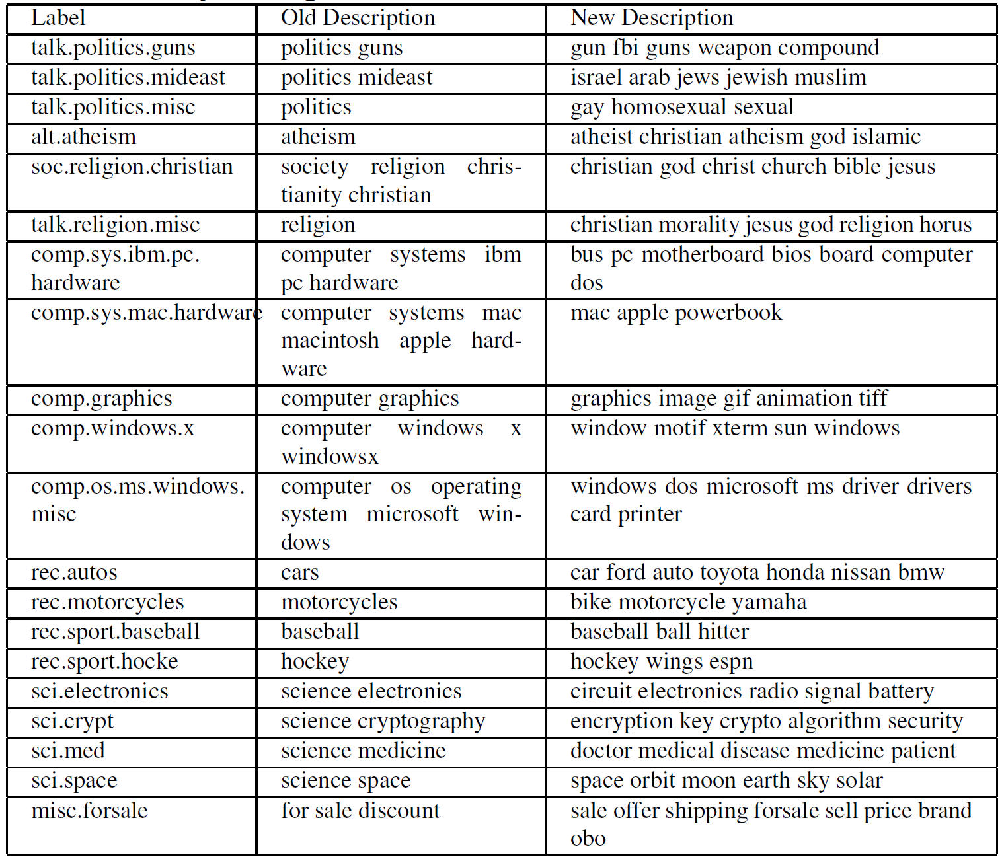
Description of labels for 20newsgroups data. Old description is used by Chang et al. AAAI, 2008.

Slide 24

Text Categorization
On Feb. 8, Dong Nguyen announced that he would be removing his hit game Flappy Bird from both the iOS and Android app stores, saying that the success of the game is something he never wanted. Some fans of the game took it personally, replying that they would either kill Nguyen or kill themselves if he followed through with his decision.
Frank Lantz, the director of the New York University Game Center, said that Nguyen's meltdown resembles how some actors or musicians behave. "People like that can go a little bonkers after being exposed to this kind of interest and attention," he told ABC News. "Especially when there's a healthy dose of Internet trolls."
Nguyen did not respond to ABC News' request for comment.
Class 1
Mobile Games
7 February 2014 is going to be a great day in the history of Russia with the upcoming XXII Winter Olympics 2014 in Sochi. As the climate in Russia is subtropical, hence you would love to watch ice capped mountains from the beautiful beaches of Sochi. 2014 Winter Olympics would be an ultimate event for you to share your joys, emotions and the winning moments of your favourite sports champions. If you are really an obsessive fan of Winter Olympics games then you should definitely book your ticket to confirm your presence in winter Olympics 2014 which are going to be held in the provincial town, Sochi. Sochi Organizing committee (SOOC) would be responsible for the organization of this great international multi sport event from 7 to 23 February 2014.
Class 2
Sports
Flappy Bird
Russia
iOS
Olympics
Winter
Android
apps
champions
Sochi
stores
game
mountains
beaches
musicians
sports

Slide 25
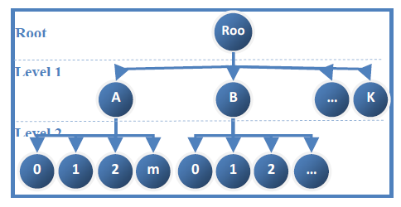
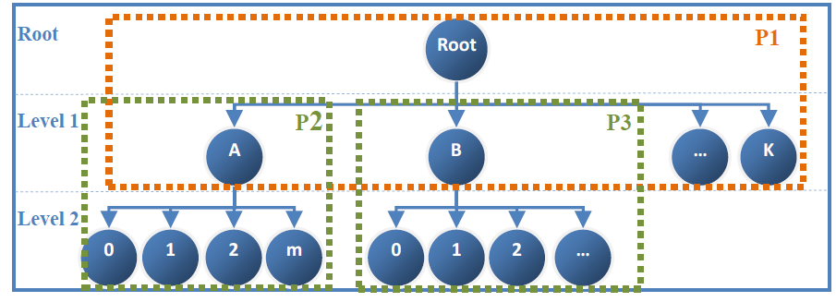
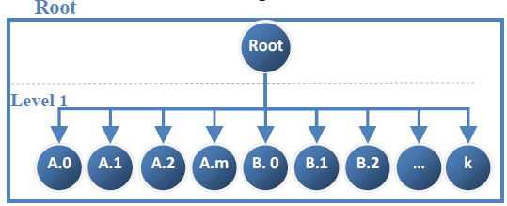
Hierarchical Classification
Original label hierarch
Top-down classification
Bottom-up classification
(Flat classification)
Notes:
Hierarchical classification is to classify documents onto a given hierarchy of labels.
It is then natural to consider a top-down or bottom-up way to classify the documents.
A top-down algorithm starts from the root node, and greedily finds the best children to further compare.
A bottom-up algorithm first compares all the leaves nodes in the tree, and propagates the labels with high confidence scores to the root. It equals to a flat classification of all the leave nodes.

Slide 26
Text Categorization (2)
Traditional text categorization
Training: Learn a classifier over a set of labeled documents
Testing: Apply the classifier to new testing documents
Limitations
Labeling/annotation is costly
For some tasks categorization is used as an indirect/side information (lack of labels)
Sentence classification → relation extraction
Event type classification → event argument detection and coreference
Possible solutions?
Dataless text classification

Slide 27


Text Categorization without Any Labeled Data
Given categories/taxonomy
Label/document semantic representation
Classify documents to the categories/taxonomy
How to represent text?
is the vector for the semantic representation of label
is the representation of document: can be both explicit and latent semantics
We select that category

Slide 28
ESA Examples (3)
Text: Tiger Woods
Wikipedia Concepts | Scores
Tiger Woods, | 61.8714
Professional golf career of Tiger Woods, | 52.1677
Earl Woods, | 33.5261
Tiger (disambiguation), | 33.3566
Woods (surname), | 29.9136
Tiger Woods Design, | 28.3550
Tiger Woods PGA Tour 07, | 27.8280
Official World Golf Ranking, | 27.5597
Tiger Woods PGA Tour 08, | 26.1357
Tiger Inn, | 25.0556
Louisiana Tigers, | 24.9915
Tiger Woods PGA Tour 14, | 24.8639
Tiger Woods PGA Tour 13, | 24.5637
Tiger Woods PGA Tour, | 24.5523
Tiger Woods PGA Tour 10, | 24.5523

Slide 29
Hierarchical Classification
Top-down classification
Bottom-up classification (Flat classification)
Root
Root
Root
A
B
B
B
…
N
1
2
…
M
1
2
2
2
…
1
2
…
Notes:
Hierarchical classification is to classify documents onto a given hierarchy of labels.
It is then natural to consider a top-down or bottom-up way to classify the documents.
A top-down algorithm starts from the root node, and greedily finds the best children to further compare.
A bottom-up algorithm first compares all the leaves nodes in the tree, and propagates the labels with high confidence scores to the root. It equals to a flat classification of all the leave nodes.

Slide 30
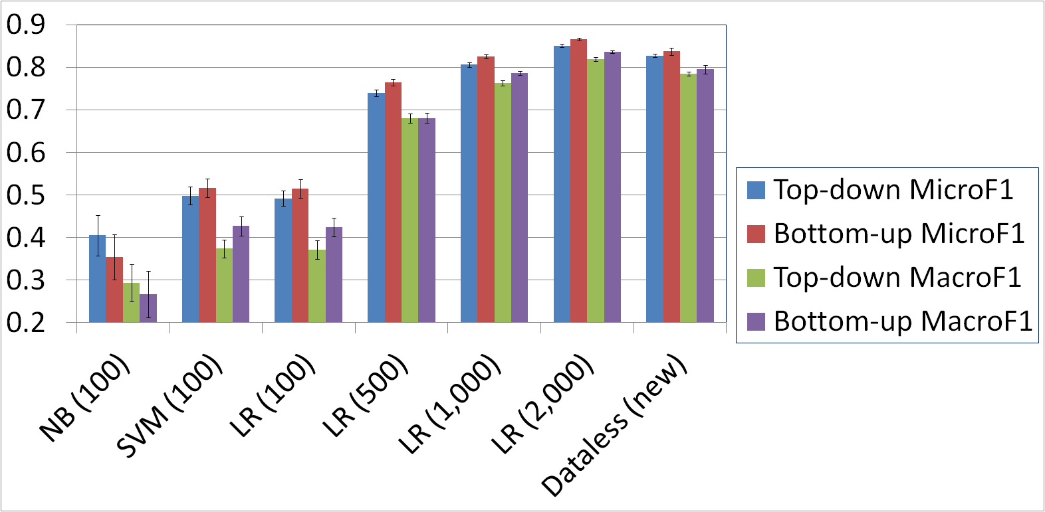
Compared to Supervised Baselines
NB: Naïve Bayes
SVM: Support Vector Machine
LR: Logistic Regression
Results on 20 newsgroups
Notes:
We tried different base classifiers including naïve bayes, svm and logistic regression. We choose logistic regression as the final base classifier for bootstrapping as it is more stable.
We can see that dataless classification is comparable to supervised classification with thousands of labeled examples.

